Slide 1
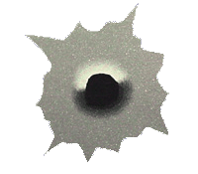
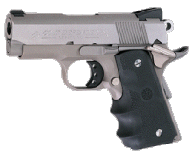
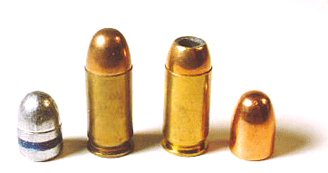
Forensic Firearm Identification, Ballistics, and Tool Marks

Slide 2
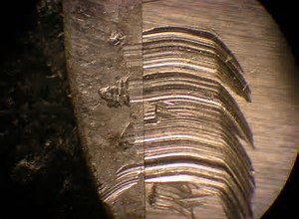
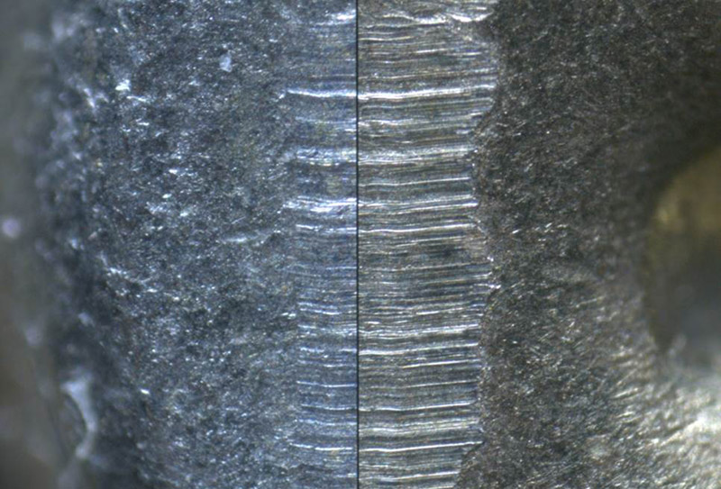
Tool Mark Evidence
When a tool is used, a pattern can be left behind.
If the surface is soft, an impression might be left behind
Many times a tool will scratch the surface

Slide 3
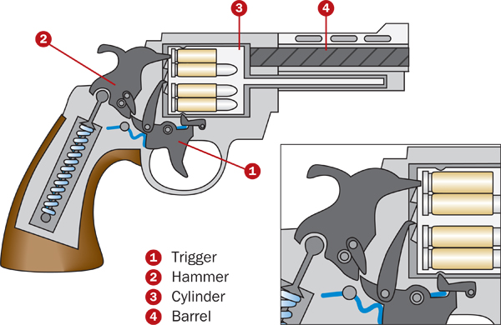
How a Firearm Works
The firing pin hits the base of the cartridge, igniting the primer powder
The primer powder sparks through the flash hole to the main propellant supply
The pressure of the explosion pushes the bullet from the casing into the barrel
The bullet follows the lands and grooves spiraling out of the barrel

Slide 4
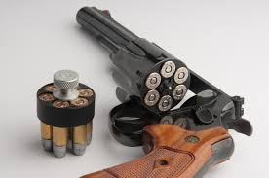
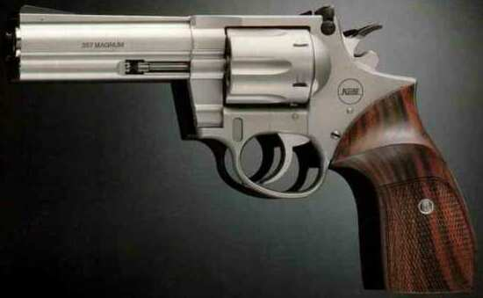
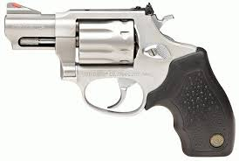
Revolver

Slide 5
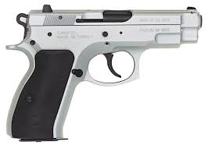
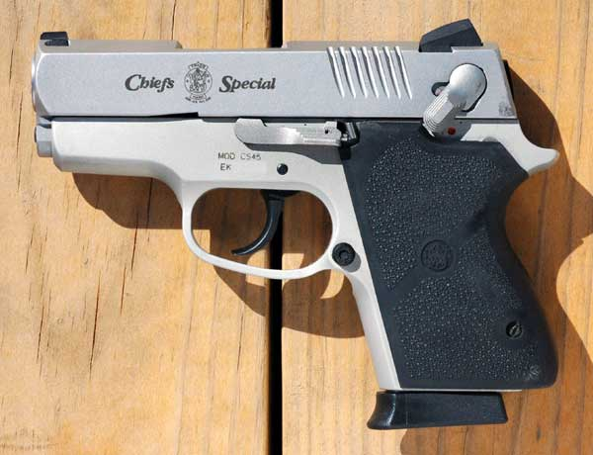
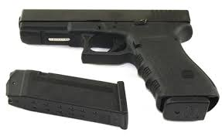
Semi - Automatic

Slide 6
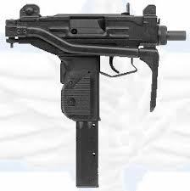
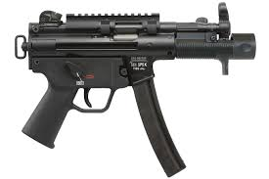
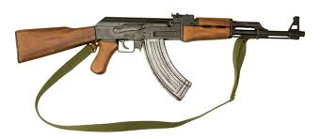
Fully Automatic

Slide 7
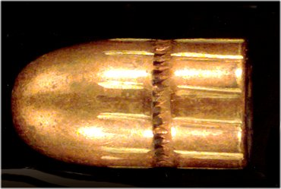
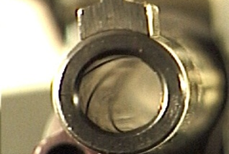
Lands and Grooves
Lands – raised areas on the bullets caused by indentations on the bore
Grooves – indentations on the bullet caused by raised areas on the bore
Lands and grooves will show evidence of a twist
  The amount of and direction of the twist are gun manufacturer characteristics (is this class or individual evidence?)

Slide 8
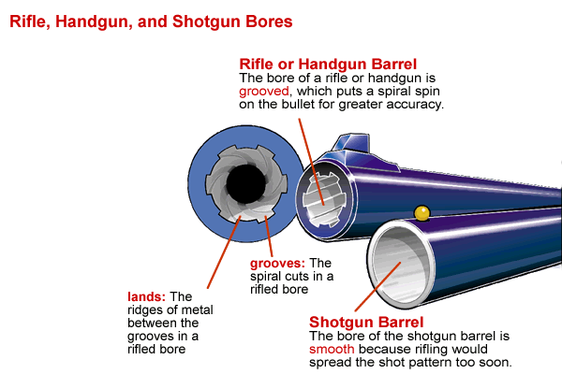
Class Evidence
Come from process of making the weapon
Will remain constant with weapons of certain type

Slide 9
Individual Evidence
When a gun is fired repeatedly, the bore takes on tiny changes
  These unique tool marks provide INDIVIDUAL characteristics that allow ammo to be traced to a gun

Slide 10
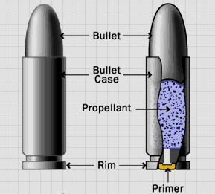
Bullets, Cartridges, and Calibers
Bullets and cartridges are packaged together.
The bullet, usually of metal, is out front with the cartridge, holding the primer and propellant powders, behind.

Slide 11
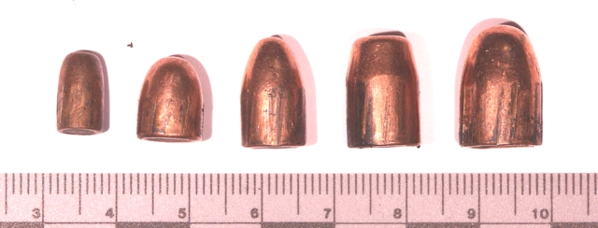
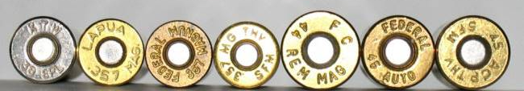
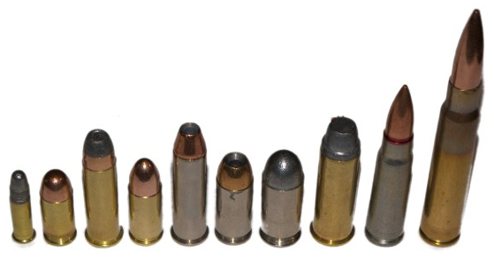
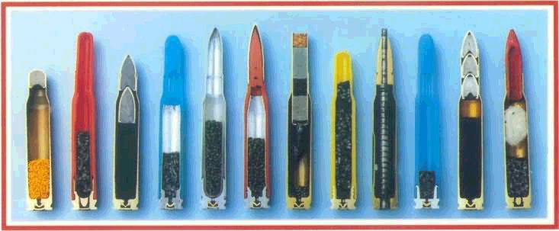
Caliber of a Bullet
Bullets are named by caliber and length.
Caliber is the diameter in inches
  Ex: .44 caliber = 44/100 of an inch
In Europe, metrics are used
  Ex: 9 mm

Slide 12
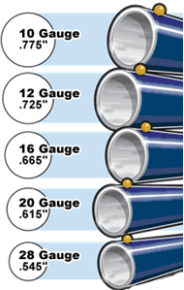
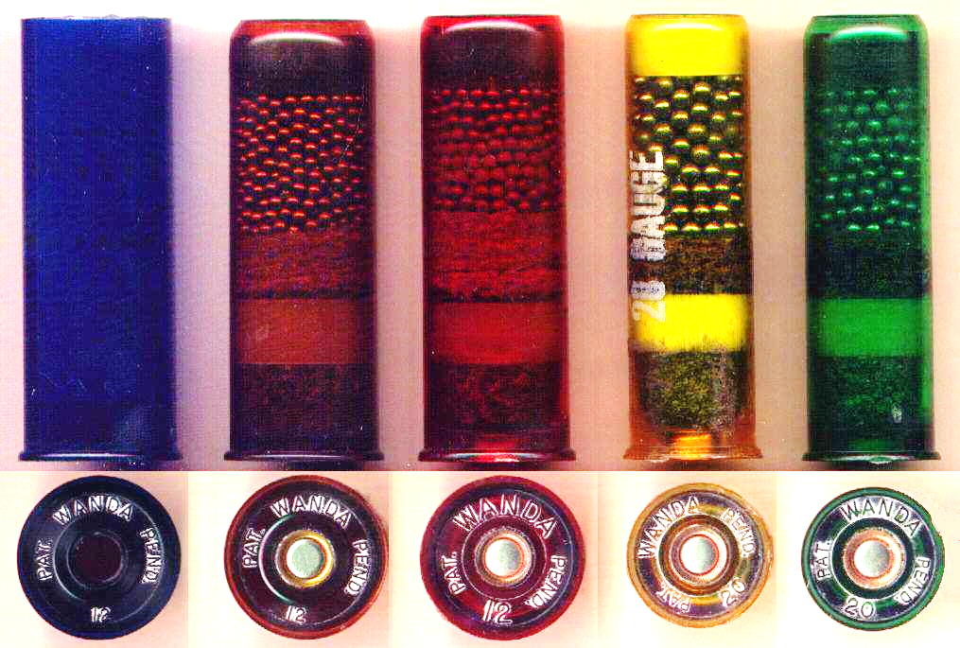
Gauge of a Shotgun
Shotgun shells are measured in gauge – the number of round lead balls per pound.
Smaller gauge numbers mean larger shot.

Slide 13
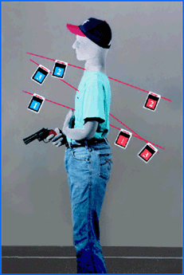
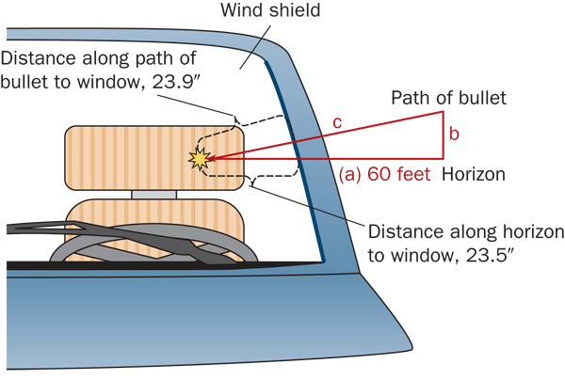
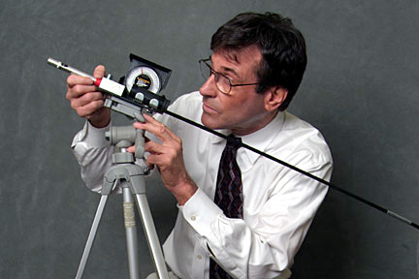
Trajectory
Two reference points are needed to define the trajectory
Affected by forward force of gun and gravity.
Used to determine location of shooter.

Slide 14
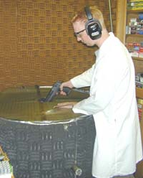
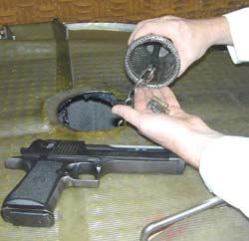
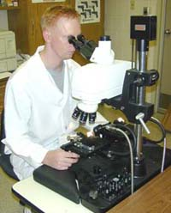
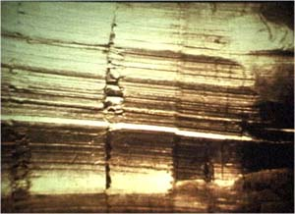
Test Fire
Comparison Microscope

Slide 15
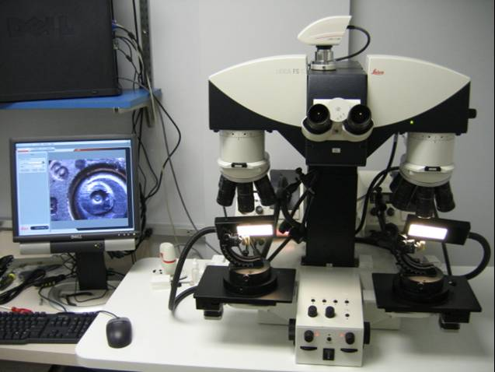
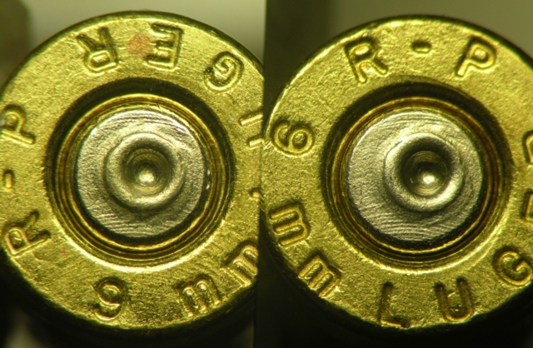
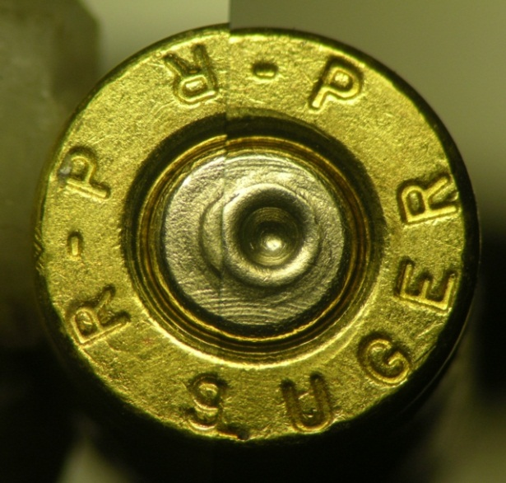
Comparison Microscope
Notes:
A comparison microscope is a microscope with two separate stages for mounting objects. These objects can be compared separately in a side-by-side view or they can be merged together to make what appears to be one object as seen in the picture on the left.

Slide 16
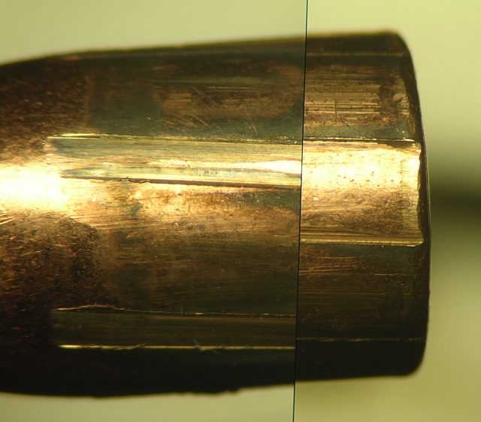
Bullet Comparison
Notes:
Some bullets may have the same caliber, number of lands and grooves and direction of twist. In order for bullet comparison to proceed, ALL class characteristics must agree. In this example, all of the class characteristics agree except the width of the lands and grooves. Because of this difference, we can exclude these bullets as having come from the same firearm.

Slide 17
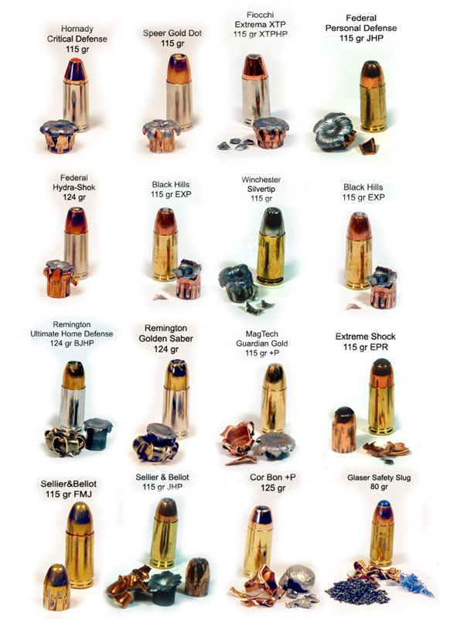
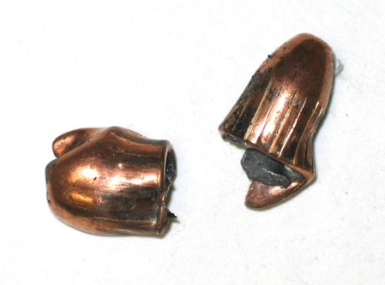
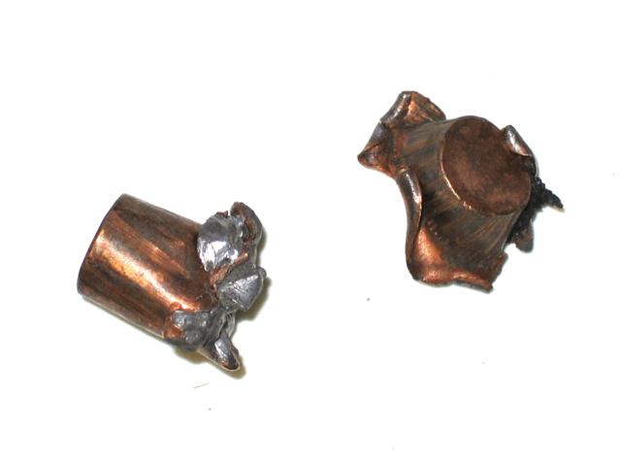
Bullet Comparisons
Usually recovered bullets only yield a small area with intact markings.

Slide 18
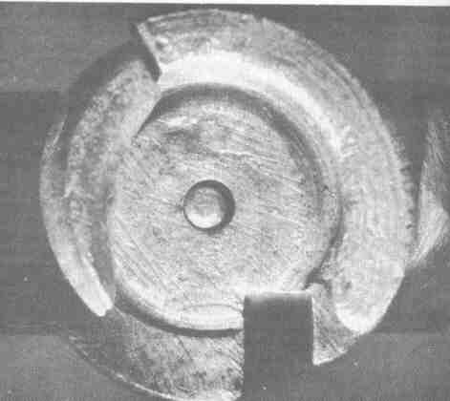
Cartridge Cases
The breechblock is the rear part of a firearm barrel.
Both the breechblock and the firing pin will leave impressions on fired shells.

Slide 19
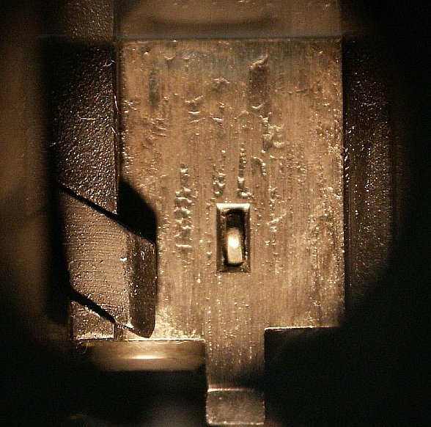
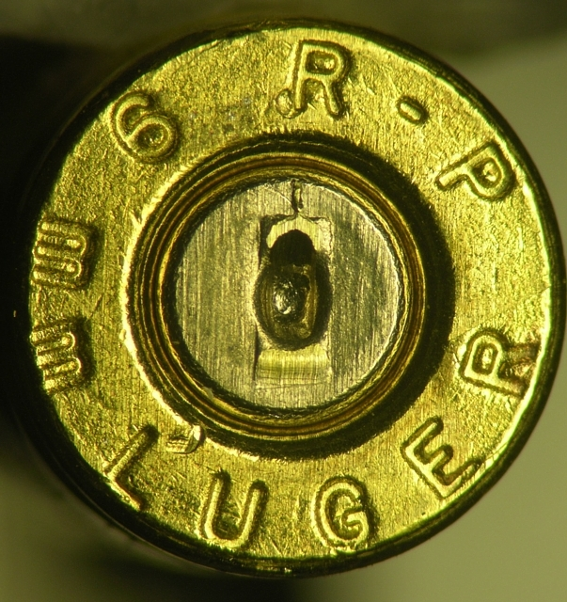
Parallel Breechface Marks
Parallel marks from the breechface transferred to the cartridge case

Slide 20
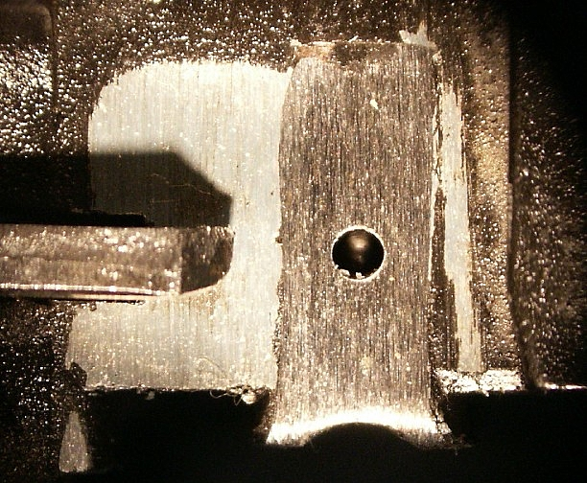
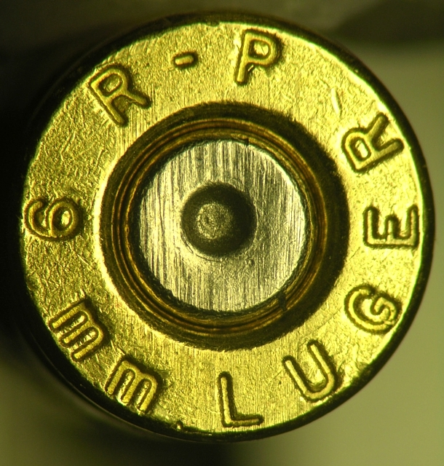
Parallel Breechface Marks

Slide 21
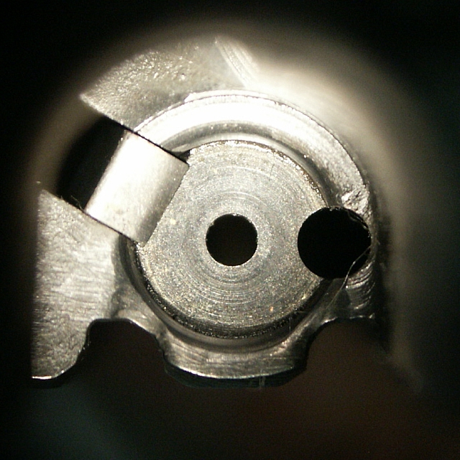
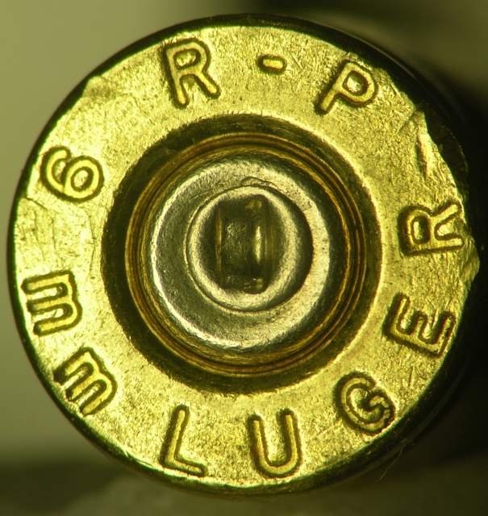
Circular Breechface Marks

Slide 22
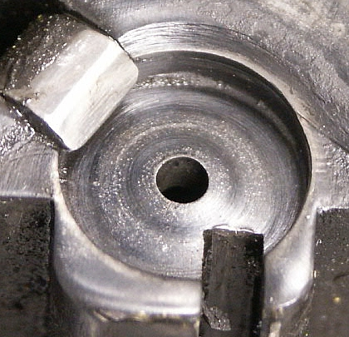
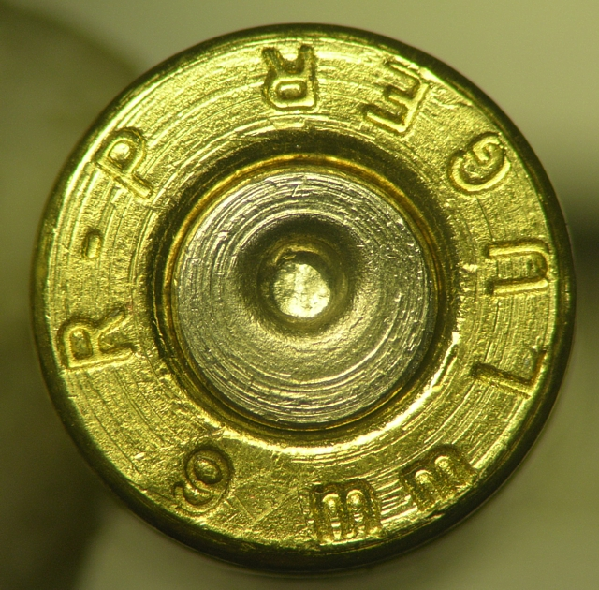
Circular Breechface Marks

Slide 23
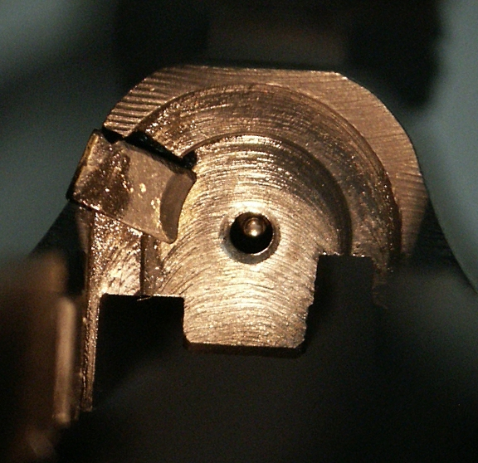
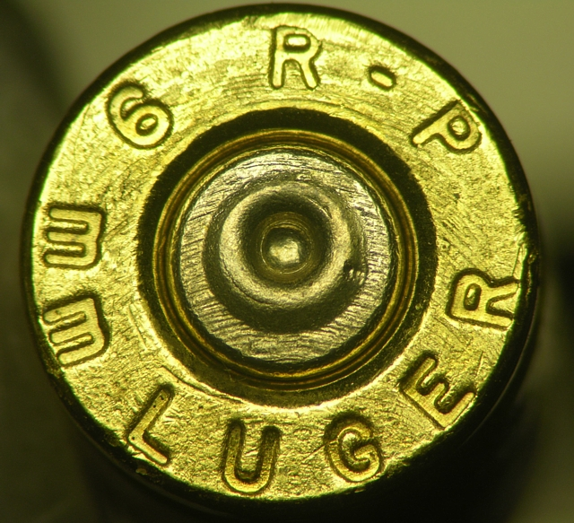
Arched Breechface Marks

Slide 24


Rectangular Firing Pin Marks

Slide 25


Rectangular Firing Pin Marks

Slide 26


Hemispherical Firing Pin Marks

Slide 27


Hemispherical Firing Pin Marks
Notice the circular marks within the firing pin impression

Slide 28


Firing Pin Comparisons
The individual characteristics within the firing pin impression can be viewed with a comparison microscope
Notes:
The individual characteristics within the firing pin can be used for comparison purposes.

Slide 29



GSR
Distance between the victim and shooter can be estimated by looking at the GSR pattern on the victim.

Slide 30


Determining Entrance and Exit Wounds
Entrance wounds are usually round and smaller than the bullet, and exit wounds are larger, and might be irregular shapes.
Fibers from clothing may show the direction the bullet traveled.
Only entrance wounds have GSR.
http://library.med.utah.edu/WebPath/TUTORIAL/GUNS/GUNINJ.html

Slide 31

Serial Number Restoration
Most automobiles and firearms are etched with serial numbers.
When these numbers have been removed it is sometimes possible to restore them with chemicals.

Slide 32




Collection and Preservation of Firearm Evidence
The best way to pick up a weapon at a crime scene is NOT with a pen/pencil…as seen on TV
You must be careful to collect the weapon in a safe way that will also preserve fingerprints

Slide 33

Ammunition
When collecting care should be taken to prevent additional scratches or mutilation.
When a semiautomatic weapon is used, the discharge pattern of ejected shells should be noted.

Slide 34


Primer Residues on the Hands

Slide 35

Gunpowder Deposits
Carefully preserve clothing of gunshot victim
Air dry clothing OUT of direct sunlight
Bag each item separately

Slide 36

The ATF has a network called NIBIN that is used to help identify which gun was used in a shooting. The database is called IBIS -
Integrated Ballistics Identification System

